Slide 1
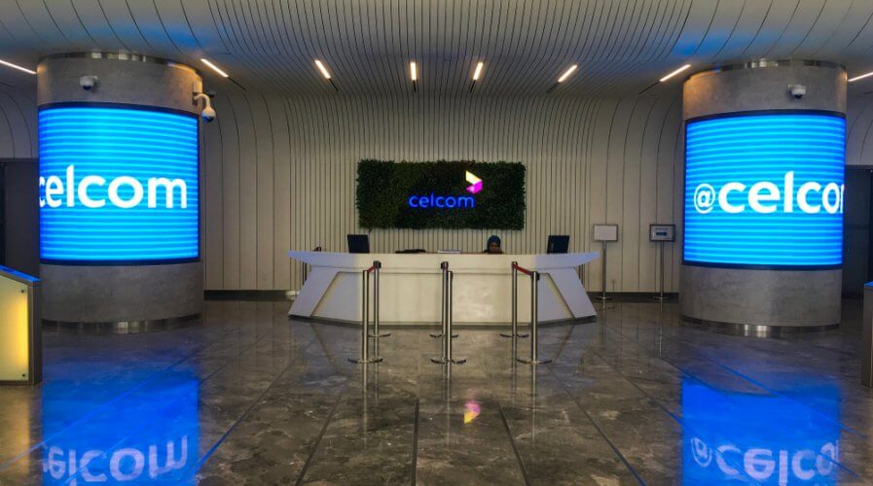

Classification Model with 93% Accuracy – Telco Customer Churn Analysis (Celcom)
12 Jan 2024
by Ahmad zaki bin ramli

Slide 2
Table of Content
Self Introduction
Course Timeline
Technology Stack
Project Overview, Problem Statement & Objective
Exploratory Data Analysis
- Education, Work experience & About me
- The period spanning from month 1 to month 6
- Language, tools and environment
- This project aims to address industry problems by achieving objectives through the defined step
- Data Inspection, Anamolies Detection (Distribution & Boxplot) & Segment dataset
Feature Impotance (Random Forest)
Predictive Modeling
Solution
Project Timeline
- Encoding, Random Forest ML, Hyperparameter Tuning & Top of feature
- Encoding, Machine learning, Hyperparameter Tuning & Result
- Recommendations for reducing churn
Project Budget

Slide 3
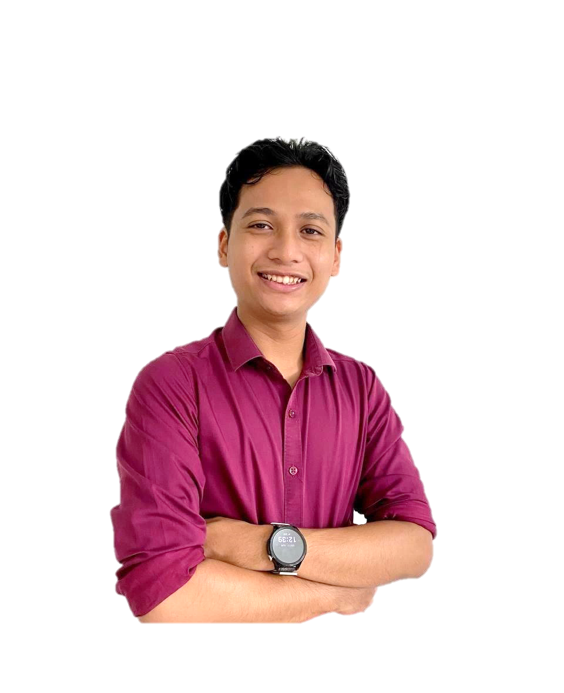






Self Introduction
About me
Name: Zaki
Hometown: Ipoh, Perak.
Current Location: Living in Putrajaya for work purposes
Passion: Determined to explore new fields and continuously learn and improve.
Education
Degree: Bachelor’s in Economics
Graduate Year: End of 2022
Challenges: Completed degree during the COVID-19 pandemic, which made learning and exams difficult due to the shift to online platforms
Achievement: Despite challenges, remained focused on pursuing personal growth and career development.
Work experience
Position: Personal MYSTEP (Graduate Program) at the Ministry of Economic Affairs
Duration: Almost 2 Years
Responsibilities: Gained experience in management and government-related work, assisting in economic projects and initiatives.

Slide 4

Course Timeline
Month 1
Month 2
Month 3
Month 4
Self resilience mastery, Communication Mastery, career Launcpad Mastery
Introduction of Data Science
Set up Environment
Introduction to Language python and Others Libraries (Pandas)
Introduction to Numpy
Data Visualization with Seaborn
Web Scraping
Introduction Language SQL
Introduction Statistical Data Analysis
Introduction to Machine Learning
Supervised Learning
Unsupervised Learning
Introduction to Recommended System
Month 6
Month 5
Final Review
Introduction to Deep Learning & NLP
Capstone Project
Self Leadership

Slide 5


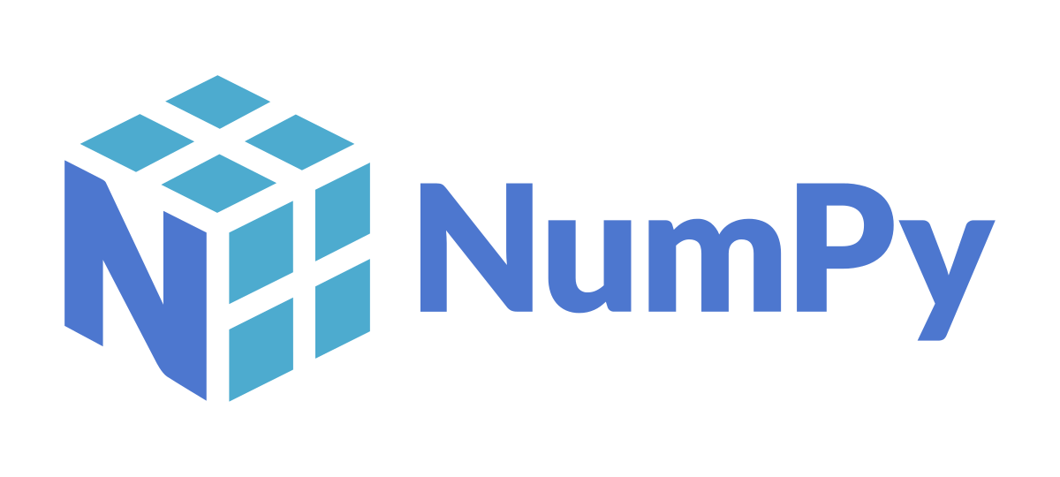




Technology Stack
Data Analysis Tools
Visualization Libraries
Machine Learning Frameworks
Development Environment

Slide 6
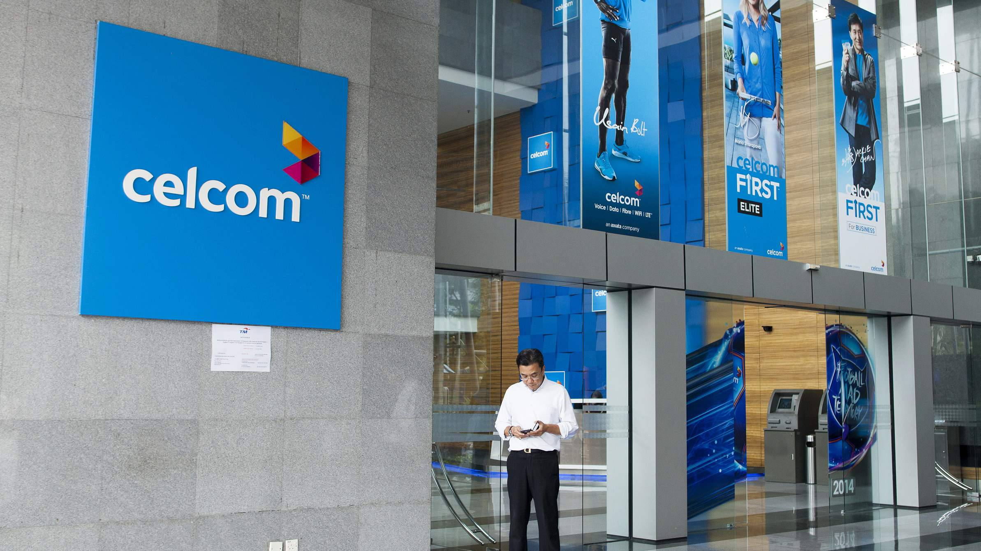
Project Overview
Problem Statement
Customer churn impacts the revenue and growth of telecommunications companies like Celcom.
Celcom needs to identify the key factors that affect customer churn, such as pricing, network quality, customer service, and service offerings.
This project aims to predict customer churn by analyzing data on Celcom's customers and their service usage patterns.
Identifying patterns and trends in the data will help Celcom improve its customer retention strategies, allowing them to take actions to prevent churn and retain valuable customers.
Customer churn directly affects the profit and growth of telecommunications companies like Celcom.
In a competitive market, companies such as Celcom, Maxis, Digi, and U Mobile face chall
Customers may leave due to factors such as pricing, service quality, customer support, or better offers from competitors.
It is important to identify the key factors influencing churn, such as network reliability, customer service satisfaction, and pricing structure.
Predicting the likelihood of churn helps companies like Celcom take effective preventive actions to retain customers.
Objective
Identify the factors influencing churn and patterns in the data.
Predict customer churn using machine learning model.
Help Celcom companies improve their customer retention strategies.

Slide 7
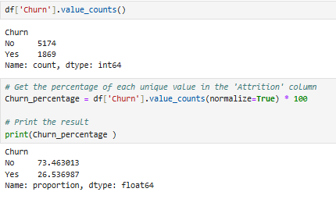
( 7043,21 )
Exploratory Data Analysis
X = FEATURE
Y = TARGET
CustomerID
Gender
SeniorCitizen
Churn
Partner
Tenure
Dependents
MultipleLines
InternetService
OnlineSecurity
OnlineBackup
DeviceProtection
Techsupport
StreamingTV
StreamingMovies
Contract
PaperlessBilling
PaymentMethod
PhoneService
MonthlyCharges
TotalCharges
Shown imbalance dataset (Churn)

Slide 8
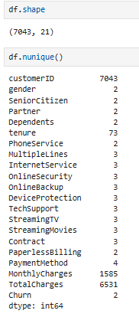
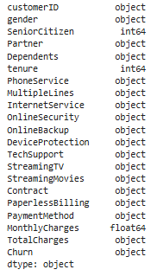
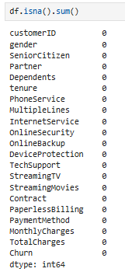
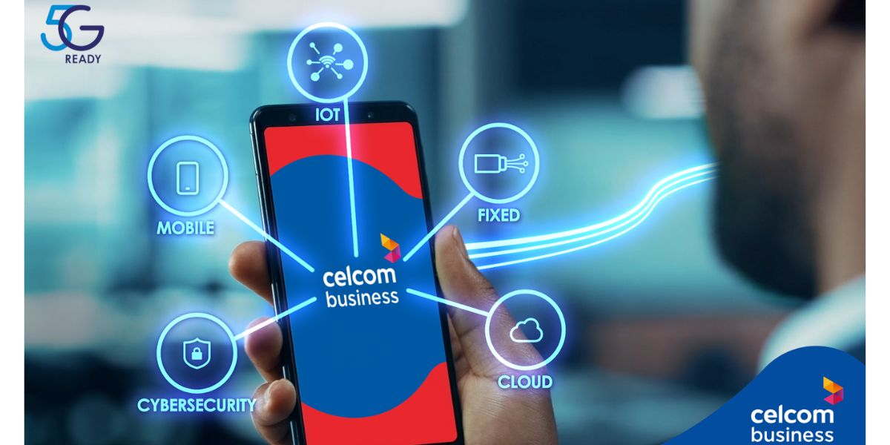
Inspection Datatypes, Missing Values
Don’t have any missing values
Exploratory Data Analysis
Don’t have any duplicated data
checking the following parts of the data for an initial review :
Datatypes
Duplicates data
Missing values
Need to change to numerical instead of object

Slide 9
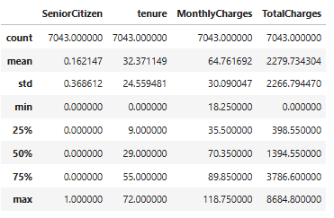
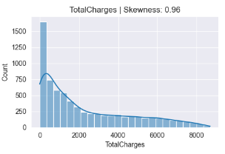
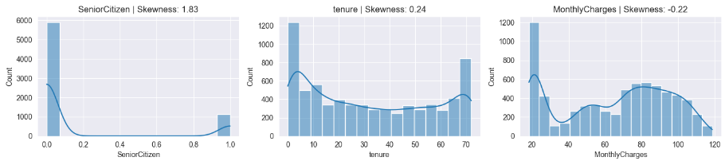
Anamolies Detection (Stats / Distribution)
Exploratory Data Analysis
Basic statistic
Total Charge looks suspicious for the first inspection

Slide 10
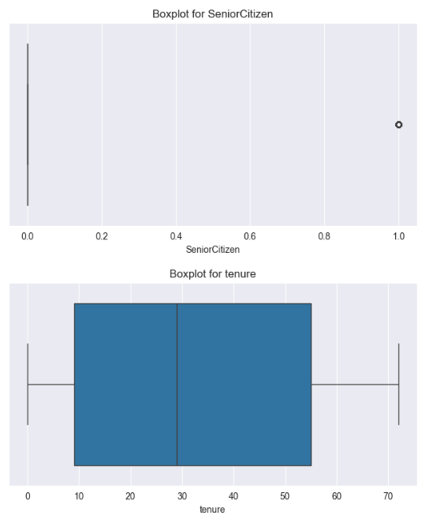
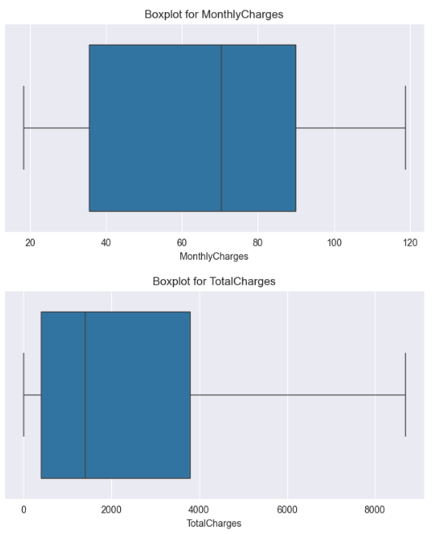
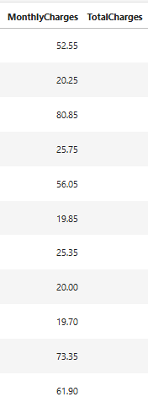
Anamolies Detection (Boxplot)
Exploratory Data Analysis
Explanation
Total Charge looks suspicious for the first inspection.
Total Charge = 0 meaning they are a new customer and its really make sense and this is not the outliers
Tenure & MonthlyCharges look ok

Slide 11
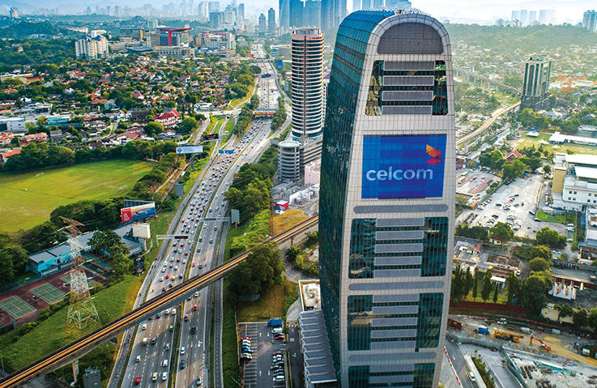
Segment Dataset
Segment using Bins and Labels
TotalCharges Cluster
Bins | -1 – 999 | 1,000 – 5,000 | 5,001 – 10,000
Labels | Low Charge (<1000) | Medium Charge (1000-5000) | High Charge (>5000)
Tenure Cluster
Bins | -1 – 11 | 12 – 36 | 37 – 120
Labels | Short-term (<12) | Medium-term (12-36) | Long-term (>36)
MonthlyCharges Cluster $
Bins | 0 – 39 | 40 – 80 | 81 – 120
Labels | Low (< 40) | Moderate (40 - 80) | High (> 80)

Slide 12
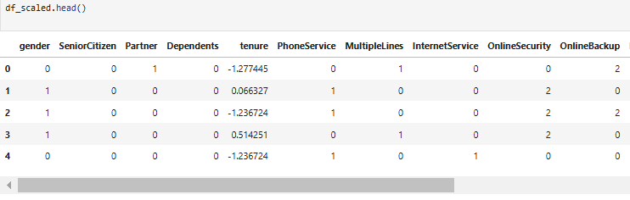
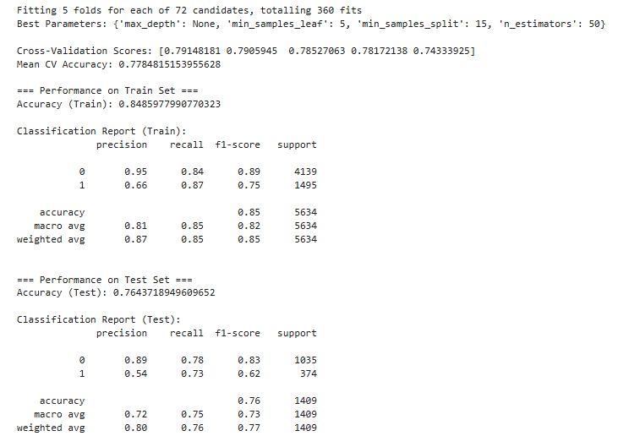
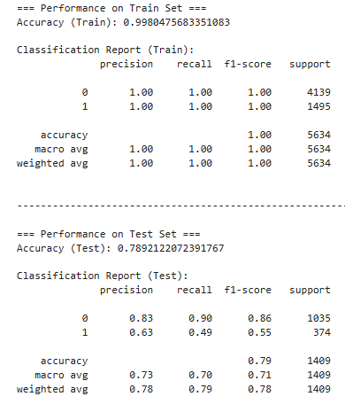
Feature Importance
Using Label Encoding
Scaling (Standardscaler)
Data Transformation
Machine Learning ( Random Forest)
Model Balance
Model Overfitting
TRAIN
TEST
After Tuning
This model ready for feature importance

Slide 13
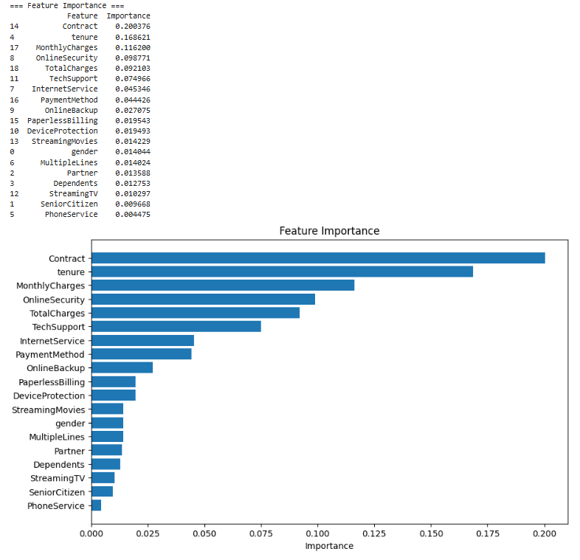
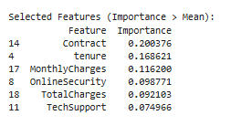
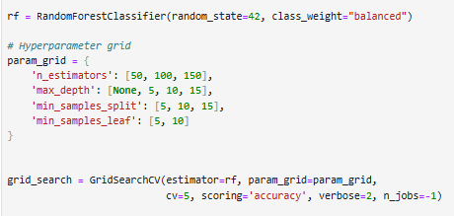
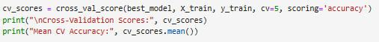
Feature Importance
Top Feature Impotance
Filtering process
Class Weight (Imbalance dataset)
Grid Search
Cross Validation
Hyperparameter Tuning

Slide 14
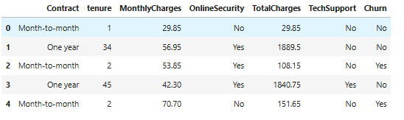
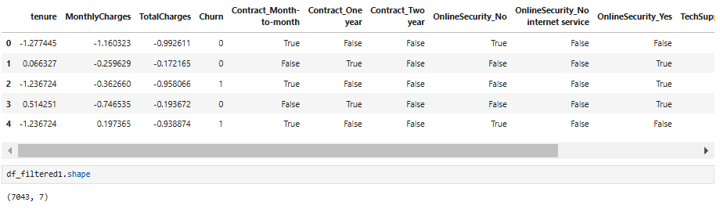
Predictive Modeling
Machine Learning
Data Transformation Using Top Feature
K- Nearest Neighbour
Random Forest
Run Model
Compare Model with Train & Test
Hyperparameter Tuning
Evalution
One Hot Encoding
Cross Validation
Grid Search
Oversampling (Imbalance dataset)

Slide 15
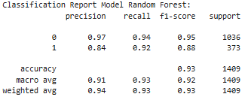
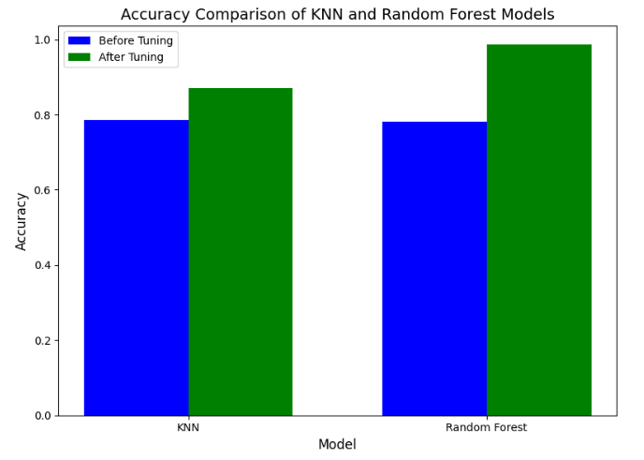
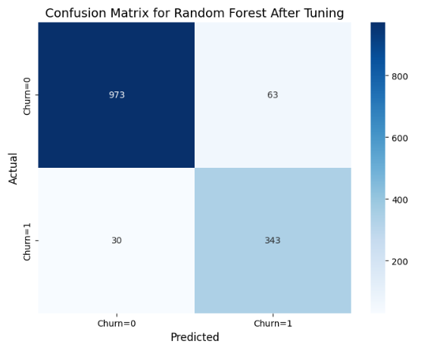
Predictive Modeling
Evaluation for Random Forest with 93% Accuracy
Result for each model

Slide 16
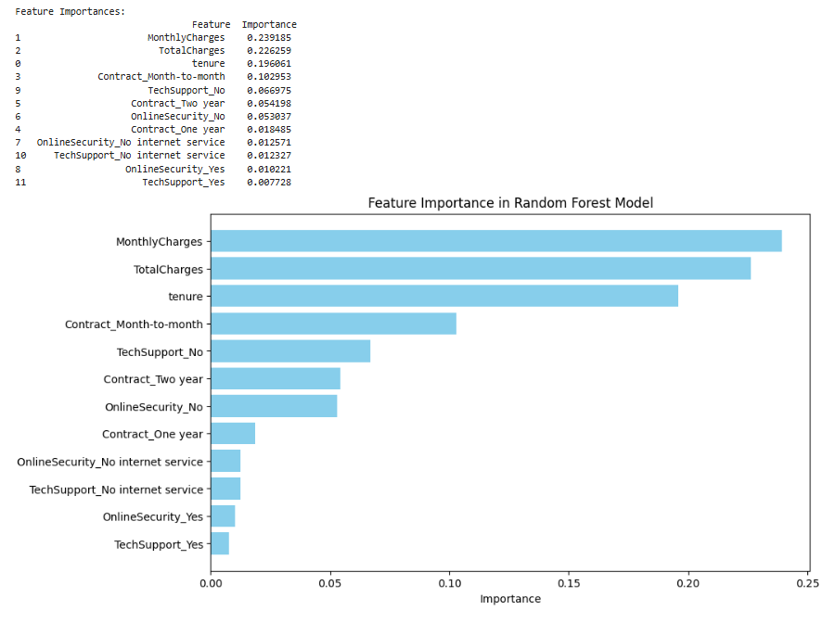
Predictive Modeling
Top Feature Impotance
Explanation
Very detail on feature importance compare with before because this dataset using One Hot Encoding

Slide 17
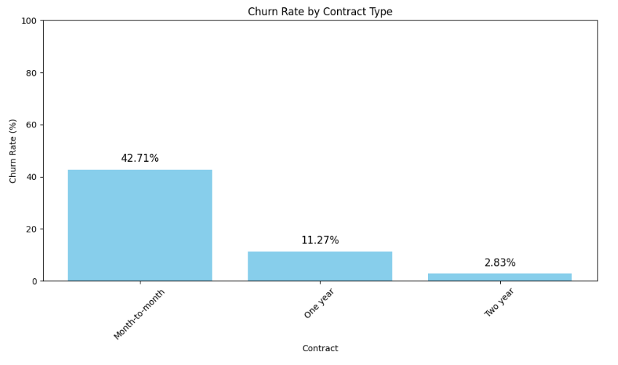
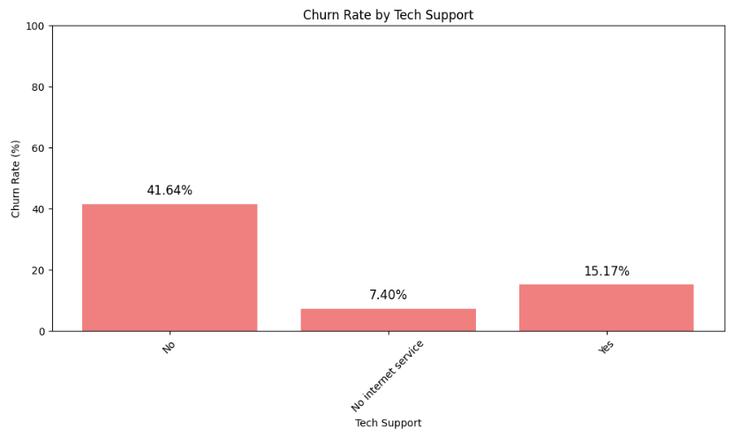
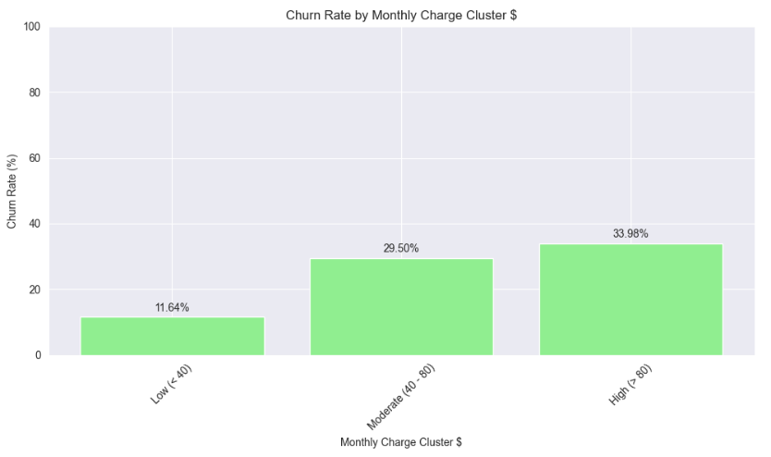
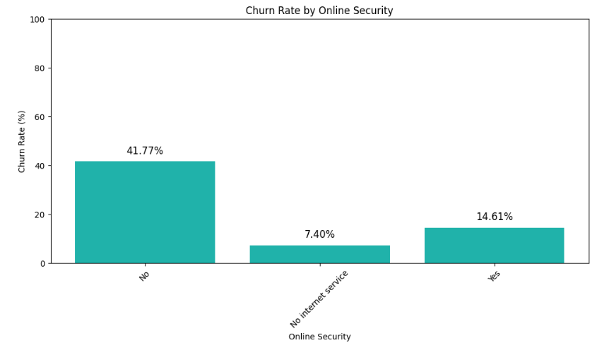
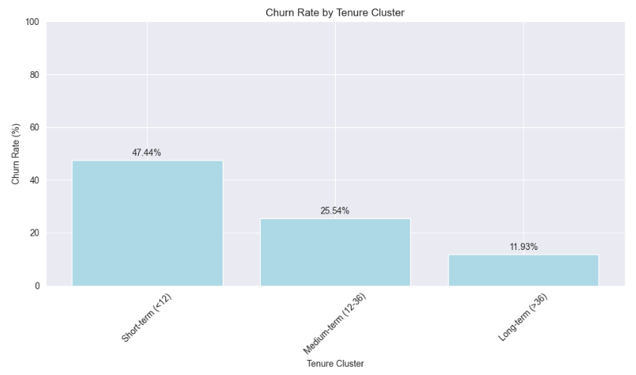
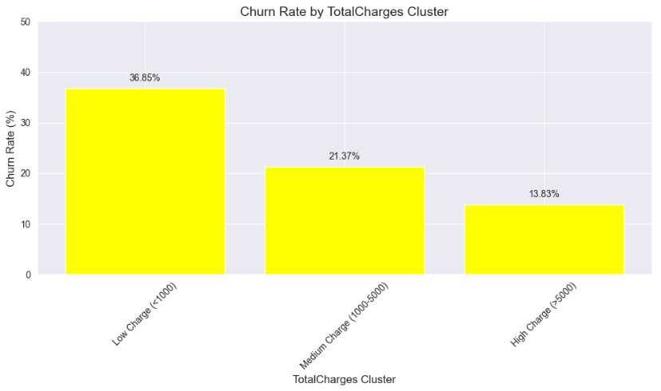
Predictive Modeling
Top Feature Influence to Churn rate
Month to month Contract Contribute 42.71 %
No Internet Service Contract Contribute 41.64 %
High Monthly Charge Contribute 33.98 %
No Online Security Contribute 41.77 %
Short Term Tenur Contribute 47.44 %
Low Total Charges Contribute 36.85 %

Slide 18
Provide Solution
Recommendations for reducing churn
Focus on Customers with Month-to-Month Contracts:
Focus on High Monthly Charges Customers:
Addressing Issues with Short-Term Tenure Customers:
Addressing Issues with OnlineSecurity and TechSupport:
Utilizing ML Models for Churn Prediction:
Introduce Customized Plans
Customer Retention Strategy
Focus on Retaining Short-Term Tenure Customers
Enhance Acces to Technical Support
Early Warning Sytem for Retentation

Slide 19
Project Timeline
Week 1 & 2
Week 3 - 5
Week 6 - 9
Week 10 & 11
Week 12
Week 13 & 14
Week 15

Slide 20
Project Budget
Criteria | Excellent (4) | Good (3) | Basic (2) | Limited (1)
Scientific method application | Thorough application; precise hypotheses | Appropriate application; clear hypotheses | Basic application; some inconsistencies | Limited application; significant gaps
Data collection and analysis | Comprehensive, accurate data; advanced tools | Accurate data; appropriate tools | Some inaccuracies; basic tools | Limited data; significant inaccuracies
Critical thinking skills | Exceptional critical thinking; integrates concepts | Effective critical thinking; logical conclusions | Basic critical thinking; limited connections | Limited critical thinking; lacks depth
Communication and presentation | Clear, persuasive communication; appropriate terminology | Clear communication; correct terminology | Some clarity; inconsistent terminology | Unclear communication; incorrect terminology

Slide 21
Conclusions
Experience
Collaboration
Being up to date
Actively seek research opportunities, such as internships, summer programs, or volunteering at laboratories or research institutions. That is key to gaining experience
Collaboration and teamwork are integral to scientific research, so foster strong interpersonal skills and the ability to work well with others
Keep up with the latest developments in your field of interest. Be open to interdisciplinary approaches and new technologies, as science is an ever-evolving discipline

Slide 22
Thank You For Your Time !

